Slide 1

WAY TO ENTERPRISE
React JS
VTI ACADEMY
Author: duy.nguyenngoc1@vti.com.vn
March 2020

Slide 2
Agenda
Share Data Between Components
Container & UI Component
Router
Assignments
Copyright © VTI Academy All Rights Reserved

Slide 3
Share Data Between Components
Composition
Lifting State Up
Context

Slide 4
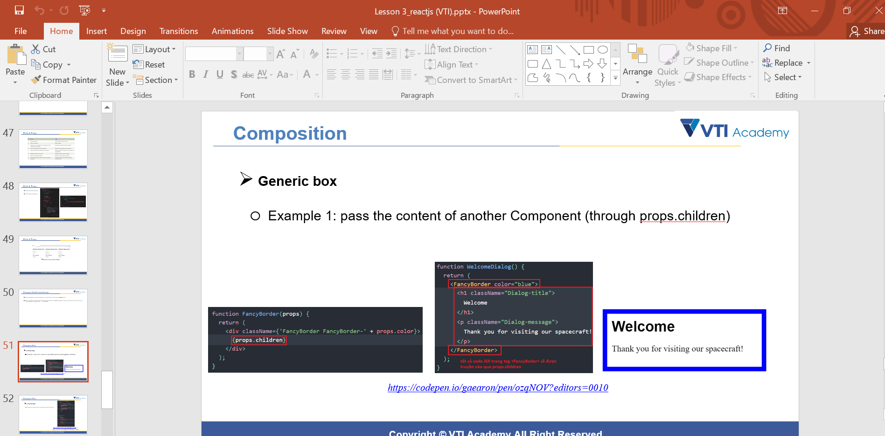
Composition
Generic Box
Base Component
Lesson 03

Slide 5
Lifting State Up Technical
Send data from parent to child component (down)
Send data from child to parent component (up)
Send data between child components

Slide 6
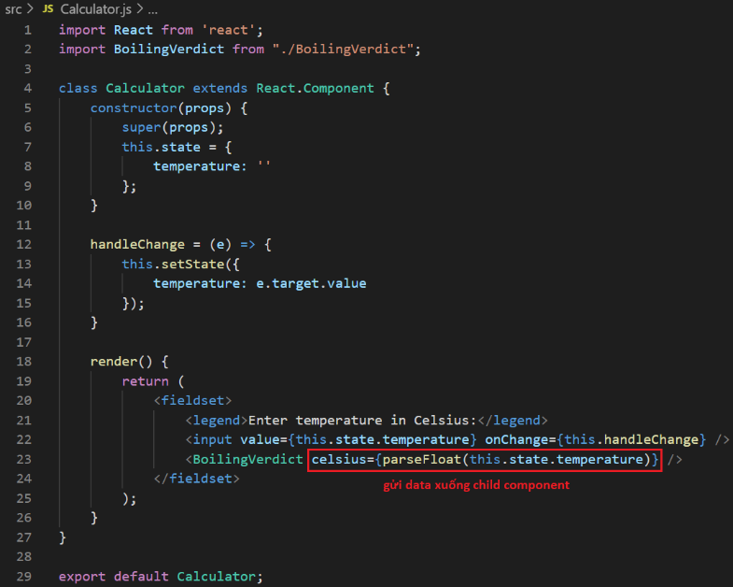
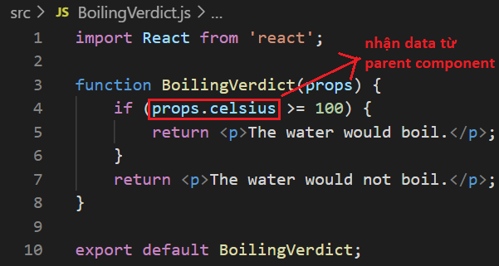
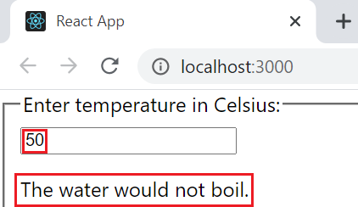
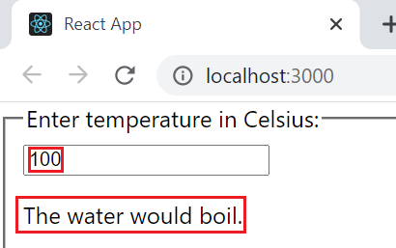
Send data from parent to child component
Example 1:
https://codepen.io/gaearon/pen/ZXeOBm?editors=0010

Slide 7
Testing System Assignment
Self-practice

Slide 8
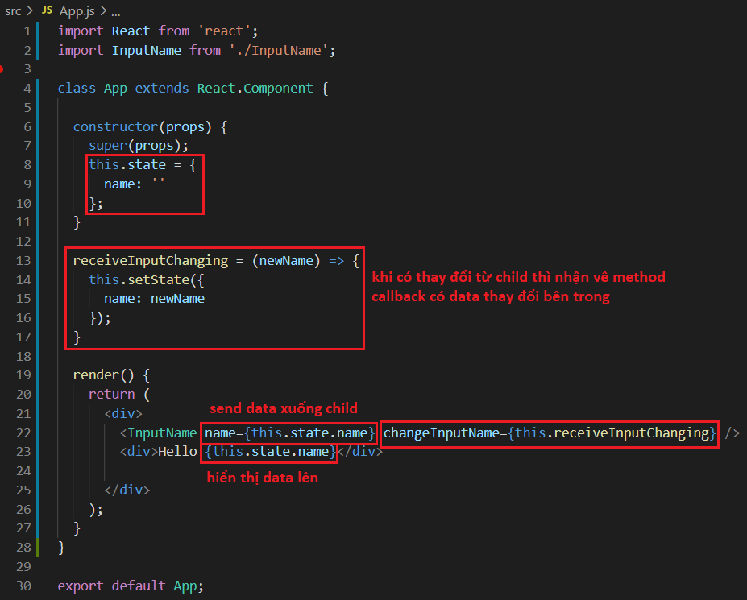
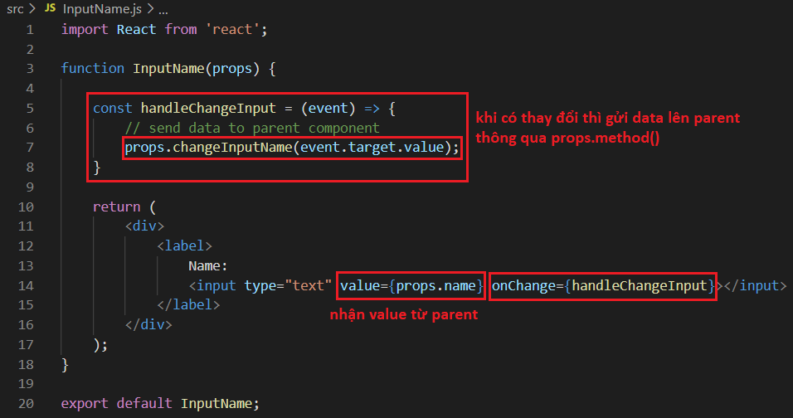
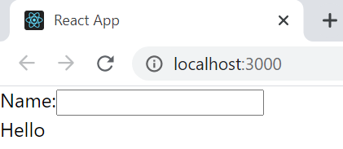
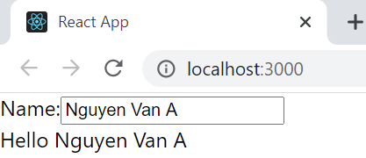
Send data from child to parent component
Example 2:

Slide 9
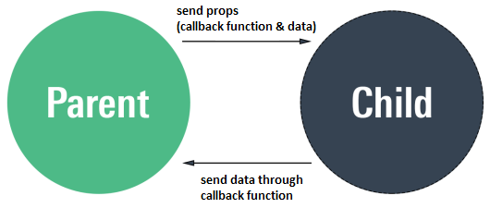
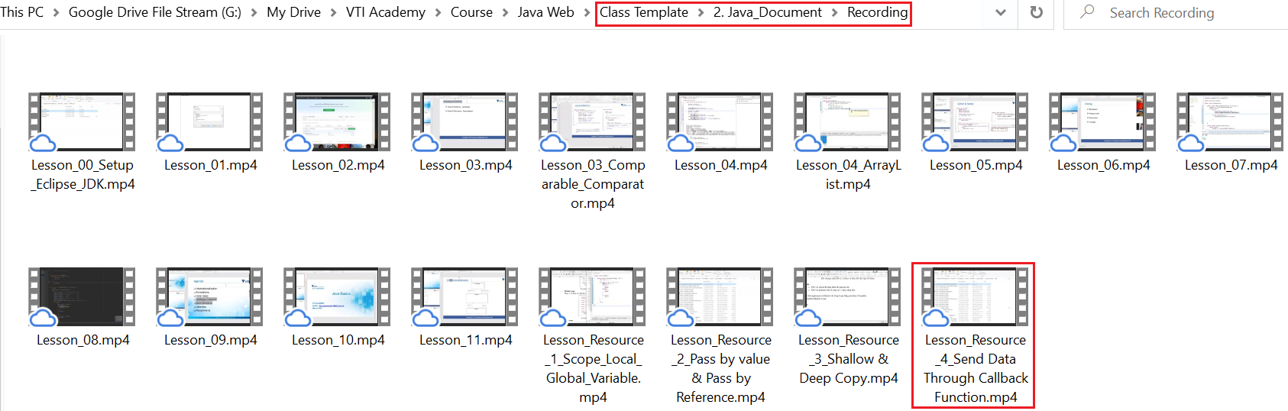
Send data between parent and child component
Send data through callback by Java

Slide 10
Testing System Assignment
Self-practice

Slide 11
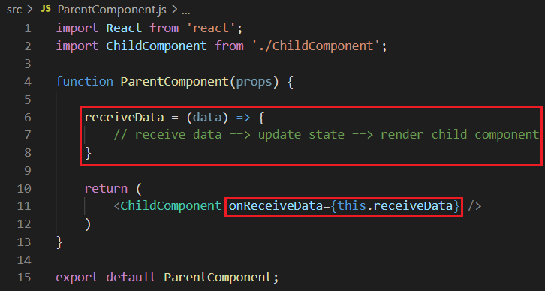
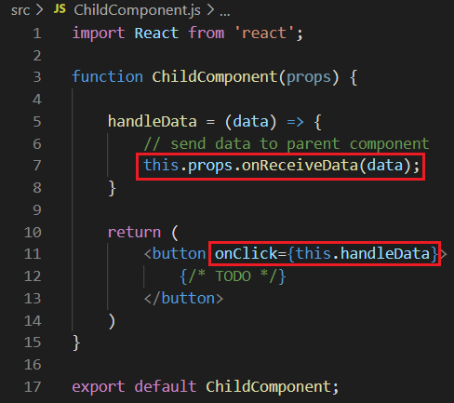
Send and receive data
Summary

Slide 12
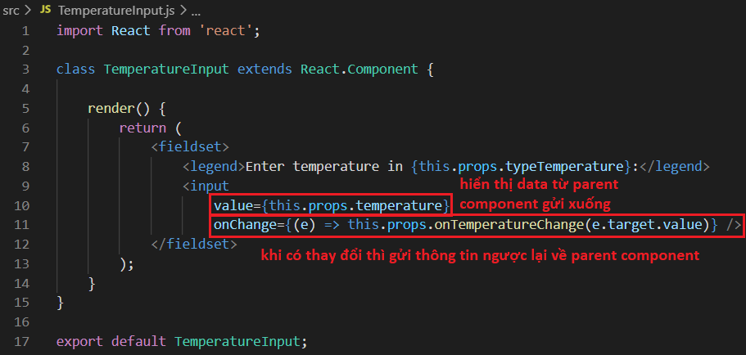
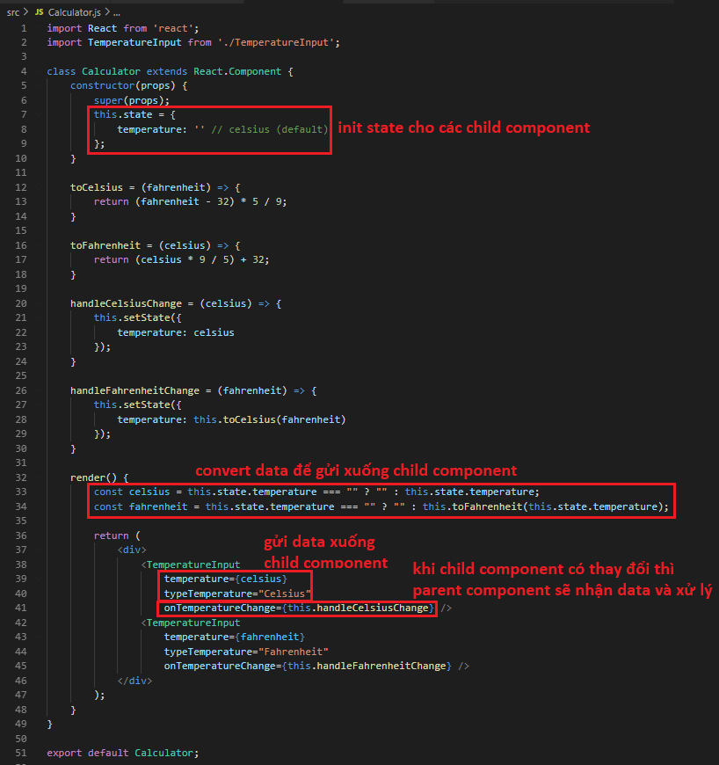
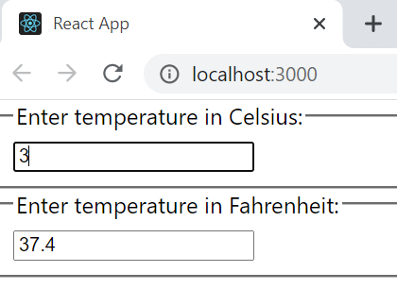
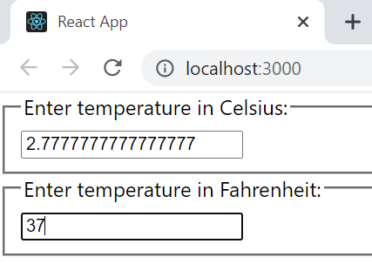
Send data between child components
Example 3:
https://codepen.io/gaearon/pen/WZpxpz?editors=0010

Slide 13
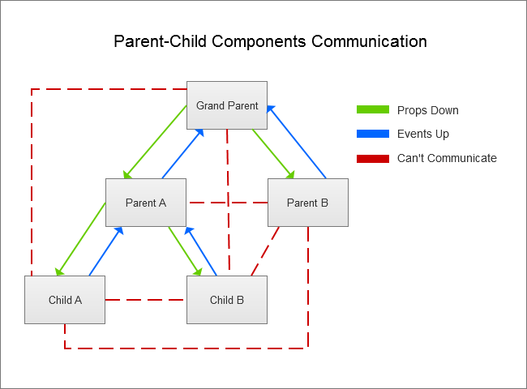
Send and receive data

Slide 14
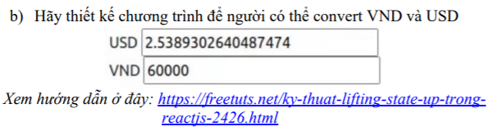
Testing System Assignment
Exercise 1: Lifting State Up - Question 3,b

Slide 15
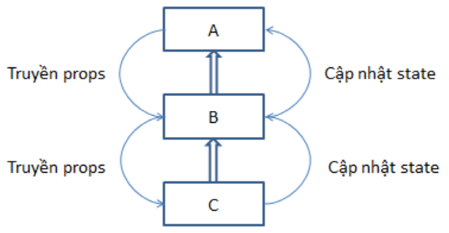
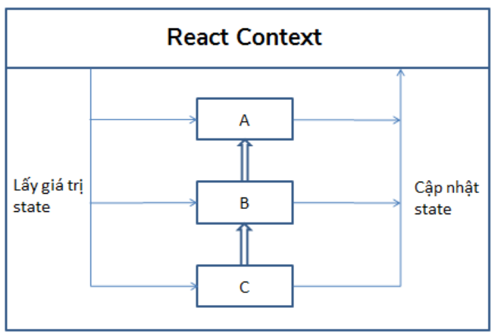
Context
Broadcast data for Component tree
Lifting state up
Context

Slide 16
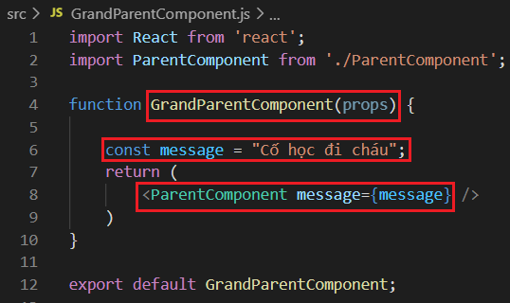
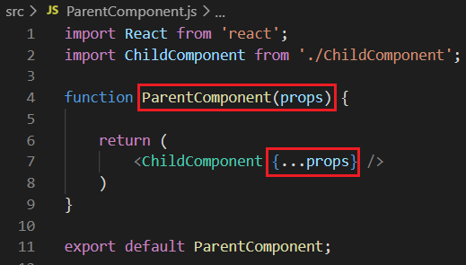
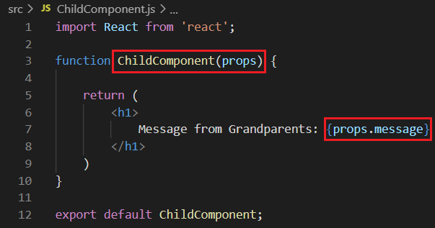
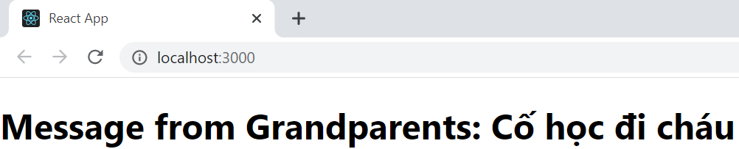
Context
Example 1:
Through props
Send data through props

Slide 17
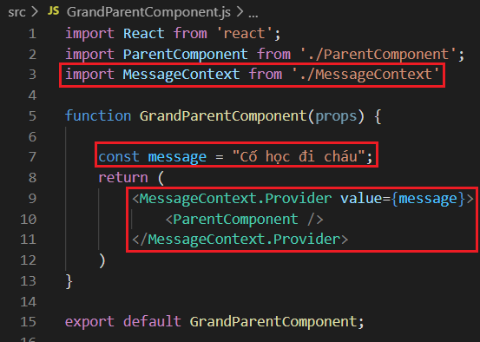
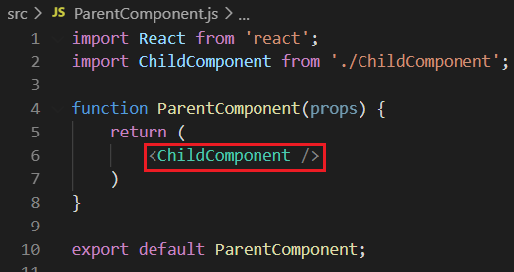
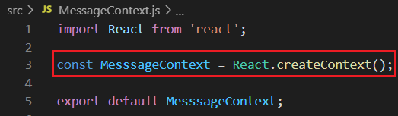
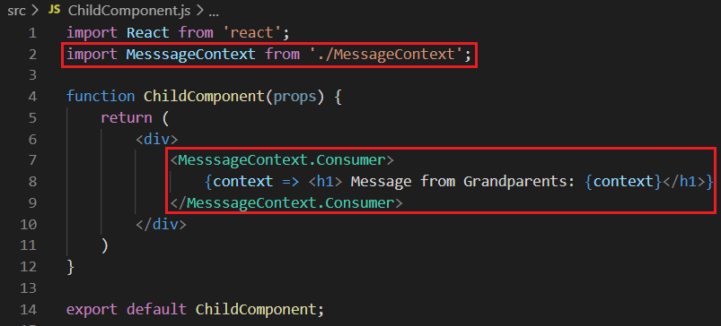
Context
Example 1:
Functional Component
Broadcast data through context

Slide 18
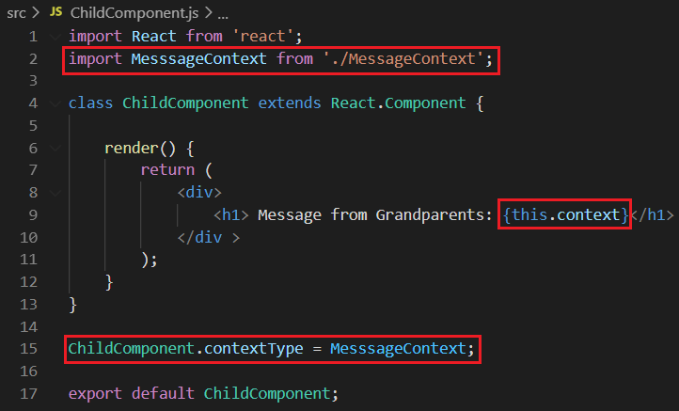
Context
Example 1:
Class component
Functional component
Class component

Slide 19
Testing System Assignment
Self-practice

Slide 20
Context
Components
Context
Provider
Consumer
Class.contextType
Context.displayname

Slide 21
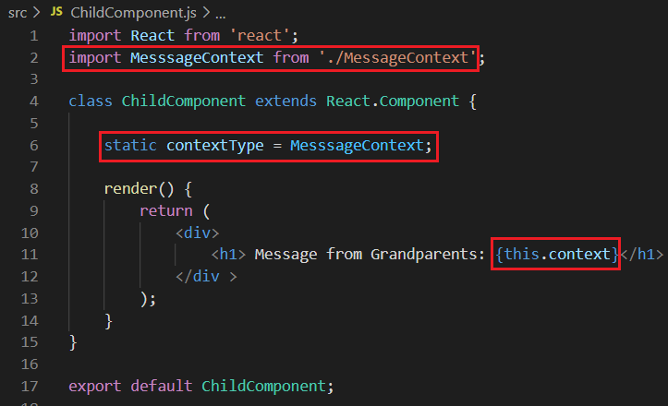
Class.contextType
2 ways
Class.contextType
public class fields syntax

Slide 22
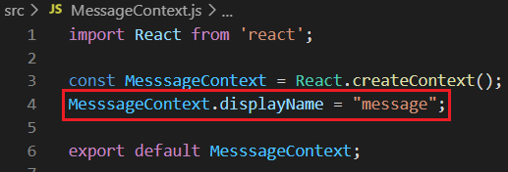
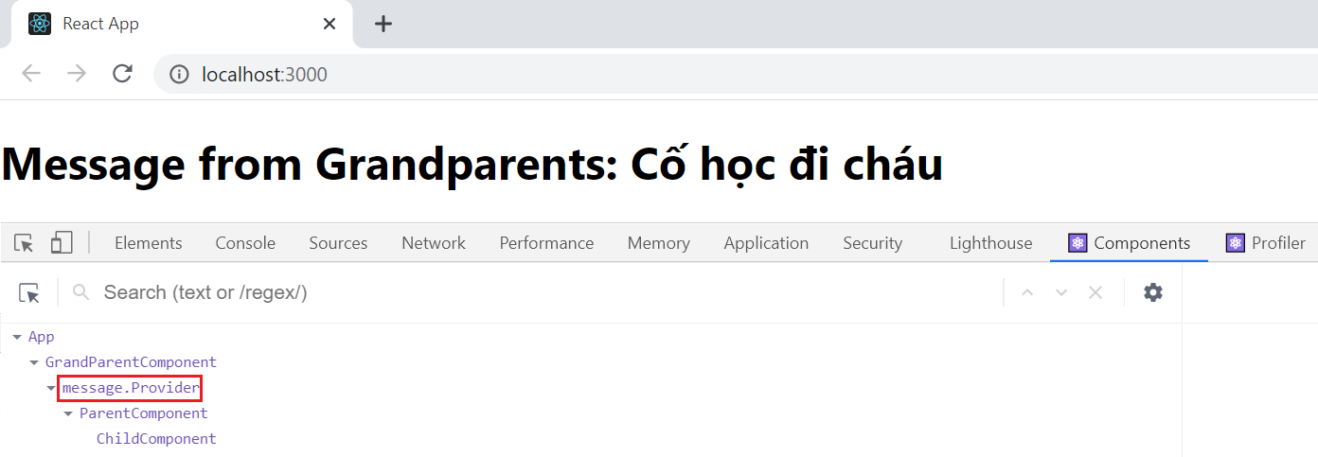
Context.displayname
React Developer Tools is used to display the context

Slide 23
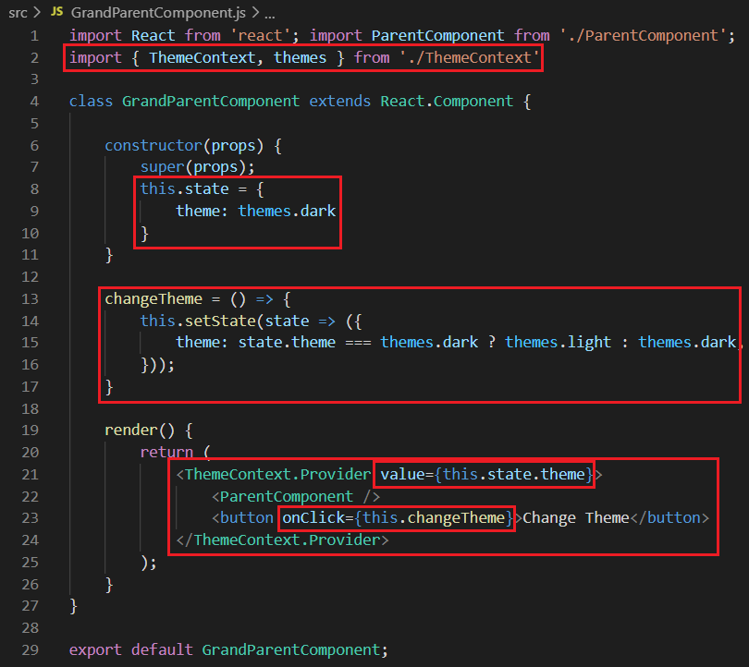
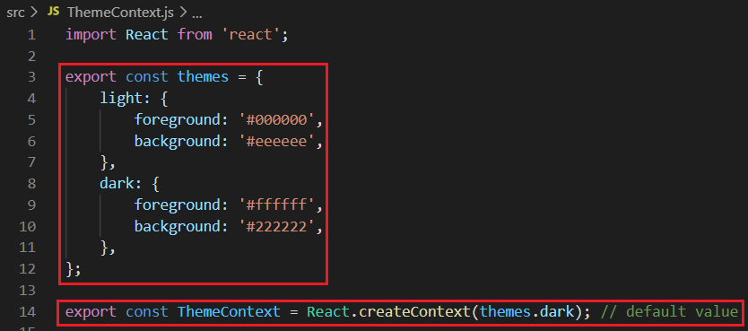
Context and State
When state changes, all the Consumer in the Component tree will re-render
Example 2: Change Themes

Slide 24
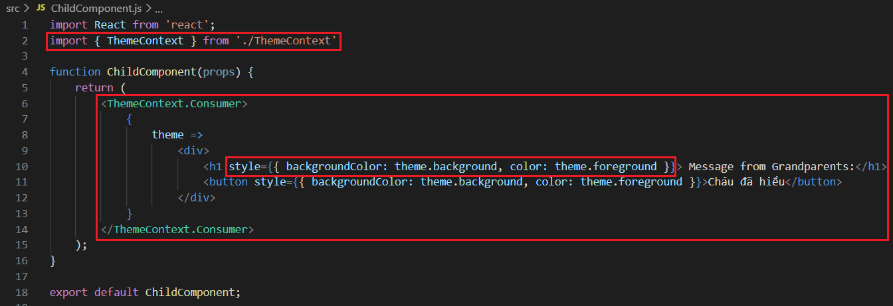
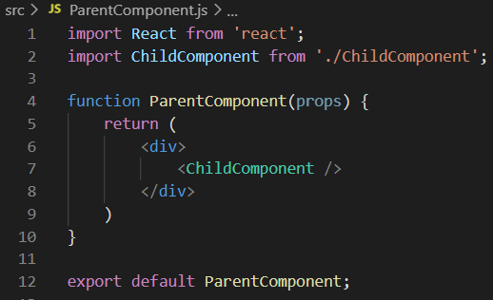
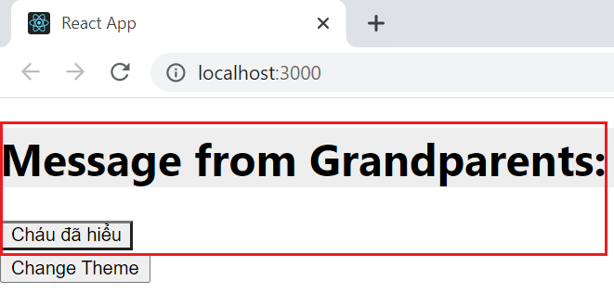
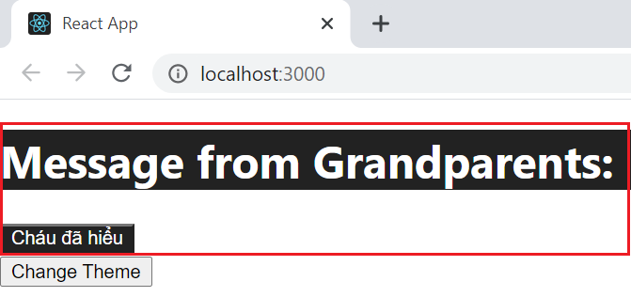
Context and State
Example 2: Change Themes

Slide 25
Testing System Assignment
Self-practice

Slide 26
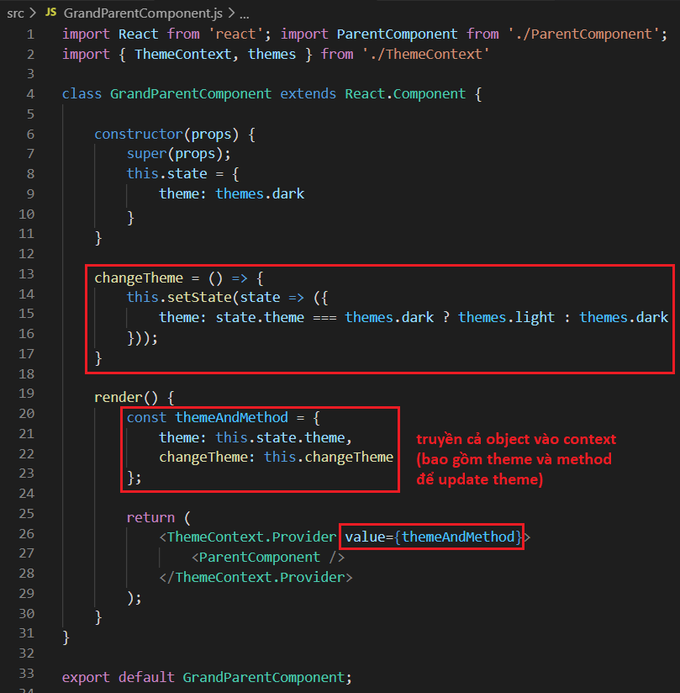
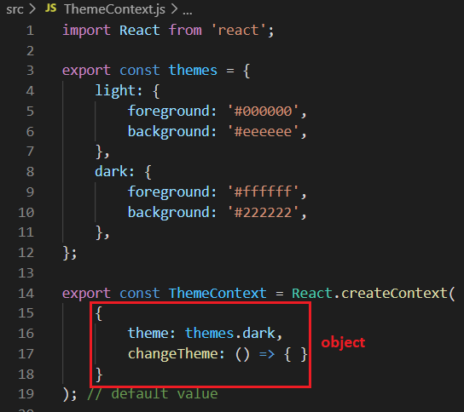
Update Context from Child Component
Pass a function into the context to allow consumers to update
Example 3: Change Themes

Slide 27
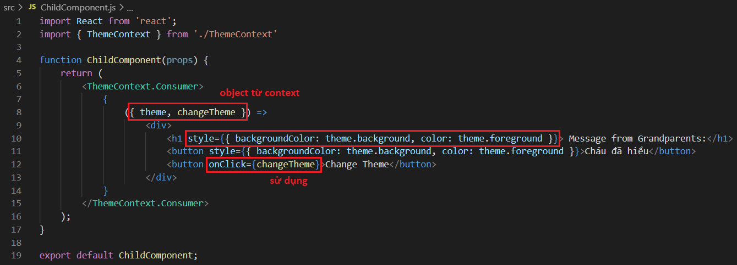
Update Context from Child Component
Example 3: Change Themes

Slide 28
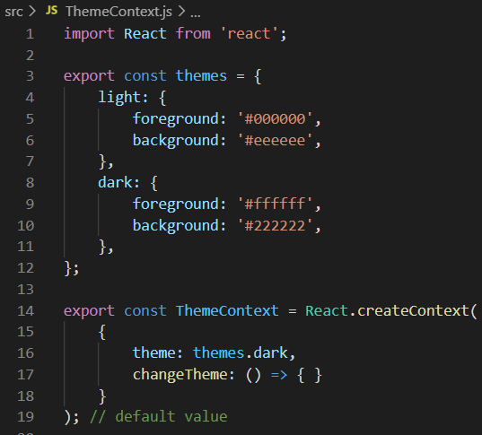
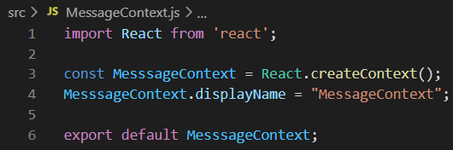
Consuming multiple Contexts
Split multiple contexts to quickly re-render the Component tree
Example 4: Change Themes + Message
Context

Slide 29
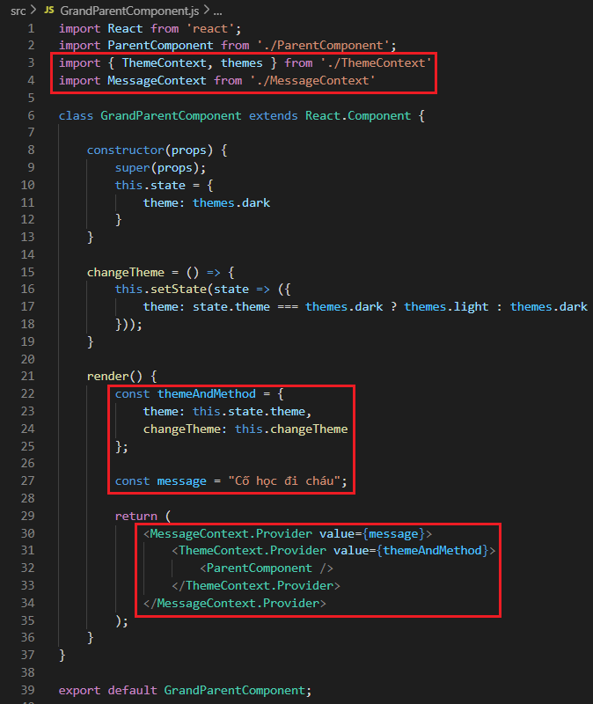
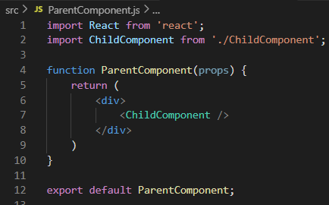
Consuming multiple Contexts
Example 4: Change Themes + Message

Slide 30
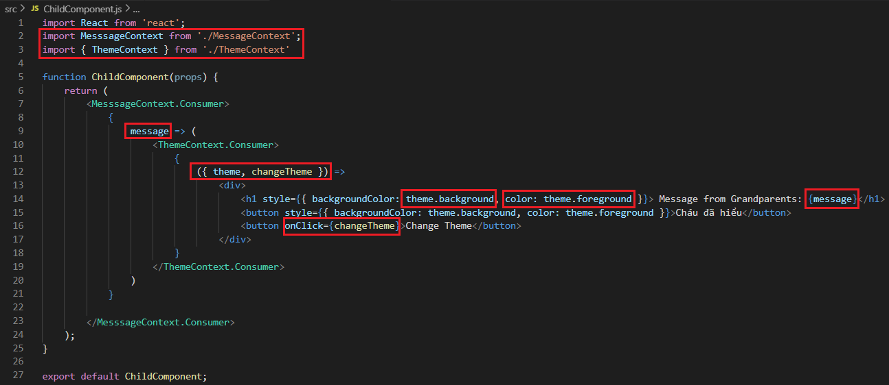
Consuming multiple Contexts
Example 4: Change Themes + Message

Slide 31
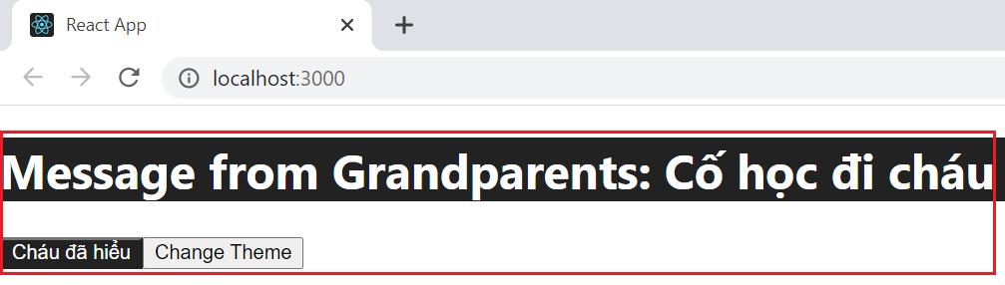
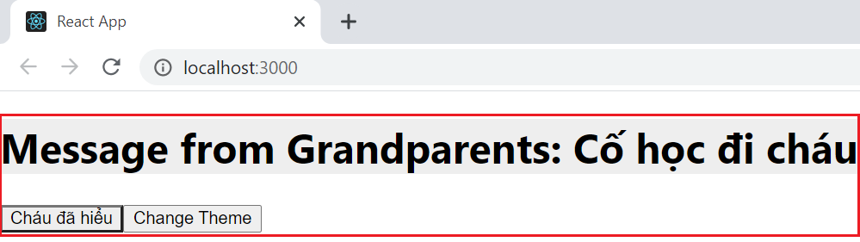
Consuming multiple Contexts
Example 4: Change Themes + Message

Slide 32
Testing System Assignment
Self-practice

Slide 33
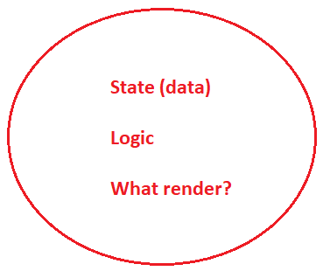
Container & UI Component
Container
Manage data & logic, call API
Don’t care how to render UI, only care what render
Contain & Manage child components,
Contain child containers
Other names: Class Component, StatefulComponent, SmartComponent

Slide 34

Container & UI Component
UI Component
Display UI
Can handle local logic
Reusable
Other names: Functional Component, Stateless Component, Dump Component

Slide 35



Container & UI Component
Example 1:
UI Component
UI Component
Container

Slide 36

Container & UI Component
Example 1:

Slide 37


Container & UI Component
Example 2:
Container

Slide 38


Testing System Assignment
Exercise 3: Container & UI Component
https://codesandbox.io/embed/x8omy0p9z
https://www.codementor.io/@blizzerand/building-forms-using-react-everything-you-need-to-know-iz3eyoq4y

Slide 39

Container & UI Component
Example 4:

Slide 40

Router
React Router is a library for navigation in React that keeps the UI in sync with the URL
Using for single page
npm install react-router-dom

Slide 41




Router
Example 1:
Pages

Slide 42


Router
Router

Slide 43


Router

Slide 44
Testing System Assignment
Self-practice

Slide 45




Router
Example 2: Nested route
match
route
Intermediary
(send match object)
Should use Template String instead of + Operator
param

Slide 46

Router

Slide 47
Testing System Assignment
Self-practice

Slide 48
Router
Components
Routers
<BrowserRouter>, <HashRouter>
Route matchers
<Route>, <Switch>
Navigation
<Link>, <NavLink>, <Redirect>, <Prompt>
history.push(), history.replace()
history.go(), history.goBack(), history.goFoward()

Slide 49

<BrowserRouter>
Convert entire application ➔ wrapped <App> tag
Using History API (HTML5) to follow routing
index.js
App.js

Slide 50

<Route>
Define mapping between URL and component
Passing match, history, location object

Slide 51


<Route>
props exact

Slide 52
Testing System Assignment
Self-practice

Slide 53
<Route>
Example: Route config
https://reactrouter.com/web/example/sidebar
https://reactrouter.com/web/example/route-config

Slide 54


<Switch>
Similar to switch case
Sequence check
Only 1 <route> display

Slide 55

<Link>
Similar to <a> tag HTML
Redirect to new Page (cannot load entire page – single page)
Using history.push()
props to similar to href

Slide 56



<NavLink>
Similar to <Link> tag
2 new props activeClassName and activeStyle
activeStyle

Slide 57
Testing System Assignment
Self-practice

Slide 58


<Redirect>
Forward to new page
Using history.replace()
prop push to add new location to history stack
https://medium.com/swlh/react-js-router-in-examples-93c778a37888
https://reactrouter.com/web/example/auth-workflow

Slide 59
Testing System Assignment
Self-practice

Slide 60



<Prompt>

Slide 61
Testing System Assignment
Self-practice

Slide 62
Location History Match Object
Location
current location information
History
Location management
Match
URL & route path matching information
Note
Object Location, History, Match must be passed through each component in Component Tree (see Example 2)
Ability to save state

Slide 63

Location Object
Current location information

Slide 64



Location Object
Example
Passing the component through the props component (not props children).

Slide 65
Testing System Assignment
Self-practice

Slide 66



History Object
Location management
3 types
browser history (for website)
hash history (for old website)
memory history (for React Native)
Properties
History stack

Slide 67


History Object
Example
Passing the component through the props component (not props children).

Slide 68
Testing System Assignment
Self-practice

Slide 69

Match Object
URL & route path matching information
Properties
Tools check
https://pshrmn.github.io/route-tester/#/

Slide 70


Match Object
Example
Passing the component through the props component (not props children).

Slide 71
Navigation
Change location
<Link>, <NavLink>
<Redirect>
history.push()
history.replace()
history.go(), history.goBack(), history.goForward()
History stack

Slide 72

Navigation
Example
History stack

Slide 73
Testing System Assignment
Self-practice

Slide 74
Router Hooks
Only using inside functional component
No need to pass through each component in Component Tree
Including:
useHistory()
useLocation()
useRouteMatch()
useParams()
Intermediary
(send match object)
route
Example 2

Slide 75

useHistory()
Return history Object

Slide 76

useLocation()
Return location Object

Slide 77

useParams() & useRouteMatch()
useParams(): return match.params
useRouteMatch(): Return match object

Slide 78

Router HOC
Using both functional and class component
withRouter()
Allow access to the latest match, location, history

Slide 79
Reference
https://reactjs.org/docs/getting-started.html
https://www.javatpoint.com/reactjs-tutorial
https://www.udemy.com/course/react-the-complete-guide-incl-redux

Slide 80

Testing System Assignments

Slide 81
Q & A
Copyright © VTI Academy All Rights Reserved

